Slide 1
Completing the Square
Dr. Frank Wood
TexPoint fonts used in EMF.
Read the TexPoint manual before you delete this box.: AAAAAAAAAAA

Slide 2
Degrees of Freedom and All That
The multivariate Gaussian has the following density
The mean of this distribution is ¹, the covariance matrix is ∑
The inverse of the covariance matrix is called the precision matrix ¤ = ∑⁻¹

Slide 3
Quadratic Form
Quite often we will find ourselves in a situation where we are given a quadratic form defining the exponent terms in a Gaussian distribution and we need to determine the corresponding mean and covariance
Often we can massage the quadratic form into the shape of the right hand side of this expression and then recover the mean and covariance of the Gaussian distribution by “inspection”

Slide 4
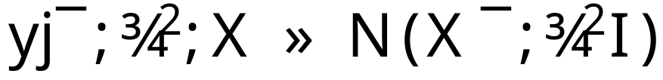
Linear regression example
Remember the ordinary linear regression setup
Where
  ¯ is a vector of unknown regression coefficients
  X is a matrix of inputs
  y is a vector of outputs
  ¾² is the unknown measurement error
  I is the identity matrix
Note: independent, identically distributed errors

Slide 5
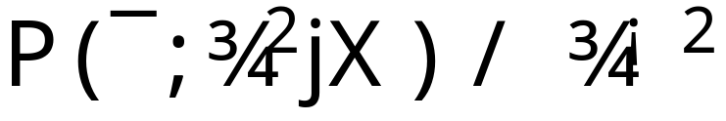
Regularization of Linear Regression Parameters
We will impose an improper prior
Why is this an “improper prior”?
Why is this OK?
  Sometimes using an improper prior results in a posterior that is still proper.
  It can be demonstrated that this is the case here.

Slide 6
What is this prior?
This prior
Is uniform on (¯, log(¾))
  How to see this?
  Method of transformations

